Slide 1

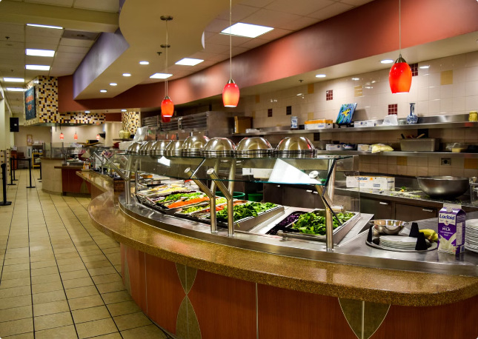
Hostel Mess Management System
Name: Siddhi Nyati Roll no: 2022btech101

Slide 2
White Hat: Facts
Current System
Proposed System
Additional Features
Students are provided with a weekly menu but do not have the flexibility to opt in or out of specific meals. Everyone is charged equally regardless of meal consumption.
Students will have the option to subscribe to specific meals, allowing them to only pay for the meals they plan to consume.
Students can submit specific dietary requests, such as for religious fasts, allergies, or specific meal preferences.
Instead of using physical notebooks, students can provide feedback by scanning a QR code.
Wastage will be tracked by weighing leftover food, and wastage data will be displayed to encourage mindful consumption.
Feedback is manually recorded in notebooks, which may get lost or become worn out, leading to inefficient handling of complaints and suggestions.
A scanner system will allow students to scan their IDs when consuming a meal, automatically registering the number of meals eaten in a month and cross-checking with the meal subscription.
The mess team prepares meals based on a generalized estimate, leading to potential over-preparation and food wastage, as there is no real-time tracking of how many students will actually eat each meal.

Slide 3
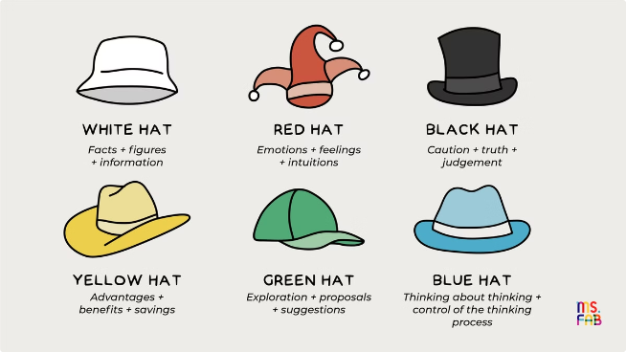
Red Hat: Emotions
1
Relief and Convenience
Students may feel a sense of relief knowing they only have to pay for meals they actually consume.
2
Empowerment
Giving students more control over their meal choices and the ability to provide feedback digitally empowers them to influence their dining experience.
3
Optimism about Food Waste Reduction
Students who are concerned about environmental sustainability will likely feel encouraged by the food wastage tracking system.
4
Comfort in Transparency
Knowing exactly what they are paying for and seeing how meal consumption is tracked will provide a sense of transparency.

Slide 4


Black Hat: Risks and Drawbacks
Technological Reliance and System Failures
Student Compliance and Adaptation
The system relies heavily on technology—QR codes for feedback, a mobile app for meal subscriptions and requests, and a scanner for tracking meal consumption.
Not all students may comply with the system’s requirements, such as subscribing to meals on time, scanning their IDs at every meal, or using the feedback portal effectively.
Complexity and User Experience
Administrative and Logistical Burden
The system introduces a lot of complexity—meal subscriptions, dietary requests, feedback, nutritional tracking, and AI-driven predictions.
The new system will require more resources from the administration—managing subscriptions, processing refunds, handling special dietary requests, tracking feedback, and ensuring technological support.

Slide 5
Yellow Hat: Benefits and Positives
1
Efficient Meal Planning and Reduced Food Wastage
The meal subscription system and pre-meal preference submissions will allow the mess team to prepare food based on actual demand.
2
Personalized and Flexible Meal Choices
By offering meal subscriptions and dietary requests, the system will provide a higher degree of personalization.
3
Transparent and Fair Billing System
The system introduces a transparent billing process, where students pay only for the meals they consume.
4
Improved Feedback System
The QR code-based feedback system offers a streamlined, accessible way for students to provide input and complaints.
5
Health and Nutritional Benefits
The system includes nutritional feedback, helping students make healthier food choices based on their preferences and dietary needs.
6
Streamlined Administration and Operational Efficiency
The introduction of AI-driven meal prediction will improve the operational efficiency of the mess team.
7
Greater Student Engagement
The collaborative menu development feature gives students a voice in deciding future meal options.
8
Enhanced Convenience and Access via Mobile App
The mobile app integration makes the entire process—from meal subscriptions to feedback and tracking—convenient and accessible.
9
Contribution to a Sustainable Future
By reducing food wastage, the system aligns with broader sustainability goals.

Slide 6






Green Hat: Creative Solutions
Dynamic Meal Customization with AI Assistance
Instead of just having a static meal preference system, the mobile app could use AI to dynamically suggest meals based on individual eating patterns, health goals, and previous feedback.
Interactive Meal Rating and Reward System
To encourage consistent student engagement, the app could feature an interactive meal rating system where students rate their meals daily.
Community-Based Food Sharing Program
To address food wastage, students who have pre-subscribed for a meal but no longer want to consume it could donate their meal to a shared pool.
Subscription Tiers with Flexibility
Introduce different subscription tiers based on the number of meals a student wants to consume per week.
AI-Powered Menu Optimization
Beyond meal demand prediction, AI could be used to optimize the menu itself.
Virtual Reality (VR) Meal Previews
For students who are particular about their food choices, the app could integrate a Virtual Reality (VR) feature where they can see 3D previews of the meals before subscribing.

Slide 7
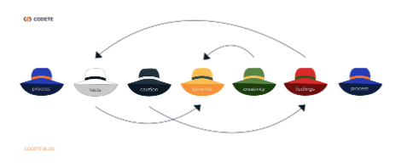
Blue Hat: Managing the Thinking Process
Objective
The primary goal is to create an efficient, student-friendly, and waste-reducing hostel mess management system.
Reviewing the Data
Gathering factual information about the current mess system, such as meal preferences, wastage levels, feedback mechanisms, and operational challenges.
Emotional Impact
Addressing the emotional reactions students may have toward the proposed changes.
Assessing Risks
Identifying potential risks and challenges, such as data security, the complexity of managing different meal plans, and technical failures in the scanning or AI systems.
Highlighting Benefits
Identifying the clear benefits of the system, such as reduced food wastage, increased meal satisfaction through personalization, and improved operational efficiency for the mess team.
Exploring Creative Alternatives
Brainstorming new and creative ideas for the system, such as AI-driven meal prediction, personalized meal subscriptions, and community-based food sharing.

Slide 8

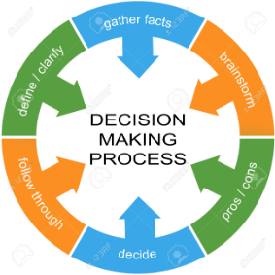




Blue Hat: Decision-Making Process
Prioritizing Solutions
Creating a Feedback Loop
Assigning Roles and Responsibilities
Timeline for Implementation
Rank the proposed features in terms of feasibility, immediate impact, and resource requirements.
Establish a regular feedback mechanism where students can provide insights on how the system is working and suggest improvements.
Clearly define who is responsible for managing different parts of the system.
Create a realistic timeline for implementing the system, starting with the most critical components.

Slide 9


Blue Hat: Monitoring Success
1
Develop Key Performance Indicators (KPIs)
Metrics could include food wastage reduction, student satisfaction ratings, and the percentage of meal preferences accurately fulfilled.
2
Regularly Track and Analyze KPIs
This will help justify further investment and improvement.
3
Gather Qualitative Feedback
It’s important not to focus exclusively on numbers, as qualitative feedback can be equally important in assessing its success.

Slide 10

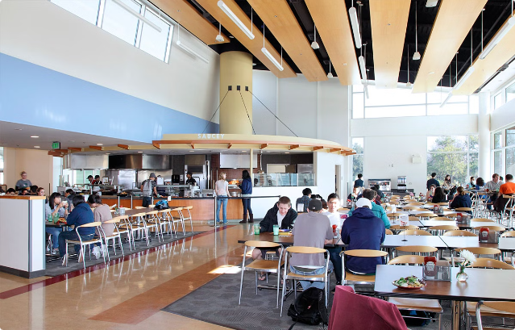
Conclusion
The Six Thinking Hats model provides a comprehensive framework for analyzing the current hostel mess management system and proposing a new system that addresses key challenges and opportunities.
By considering facts, emotions, risks, benefits, creative solutions, and decision-making processes, this analysis offers a well-rounded perspective on how to improve the mess system, reduce food wastage, and enhance the student experience.

